Slide 1


Foundation Education for Recruitment:
LET’S TALK PHILANTHROPY!
Notes:
FACILITATOR INSTRUCTIONS:
For the best experience, view this presentation as a slide show. Go to the “Slide Show” tab in the menu at top, then select “From Beginning”
Participants in the training will need something to write on and write with. There will be different activities throughout the presentation that will require them to write down their thoughts.
Slide 14 will require you to customize that slide with information on your chapter’s specific Service for Sight activities.

Slide 2
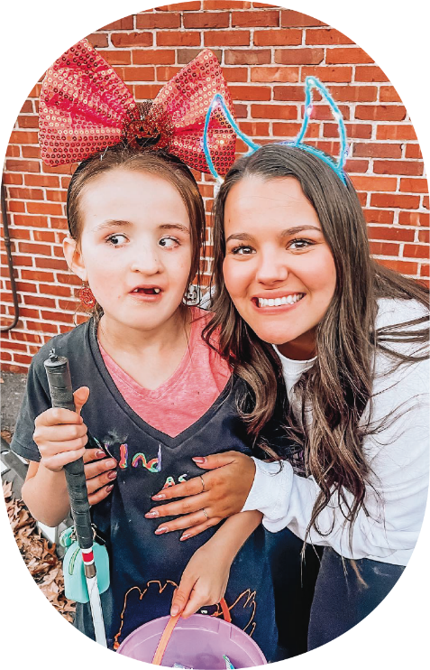
LET’S TALK
PHILANTHROPY…
and how we do good with the Delta Gamma Foundation and Service for Sight!
Notes:
SAY: In this workshop, we will:
Discover the Delta Gamma Foundation’s role in facilitating philanthropy
Explore and tell the story of Delta Gamma’s philanthropy Service for Sight
Consider how to talk about how your chapter lives out our do good motto through service and fundraising
The goal of this workshop will be for everyone to be able to describe, in two minutes or less, what Service for Sight is, why you are committed to it, and what the role of philanthropy is within Delta Gamma. Plus, you will learn more about our Foundation!

Slide 3
WHAT IS PHILANTHROPY?
Notes:
SAY: Does anyone know where the word “philanthropy” comes from? The word philanthropy comes from the Greek words "philos," which means loving and "anthropos," which means humankind. So, philanthropy is the love of humans, by promoting the welfare of others and a desire to do good for others.
ACTIVITY
Take 3-4 minutes for individual members to write down 1-2 sentences to answer in their own words this question:
How does philanthropy relate to our do good motto?
FACILITATOR NOTES: These questions will build into an “elevator pitch” for each member to have and use during recruitment and throughout the year when members speak about Service for Sight, Delta Gamma’s philanthropy.

Slide 4


Slide 5
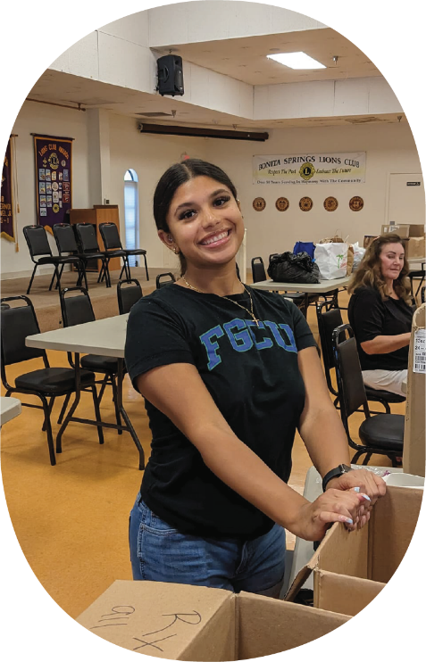
HOW WE DO GOOD…
The Delta Gamma motto is
do good, and our badge is the anchor which stands for hope.
Notes:
SAY: Delta Gamma was founded on the idea of doing good - this is why our Founders choose the letters D and G for Delta and Gamma when creating our “club of mutual helpfulness.” We do good in all parts of our lives, in big ways and small, but within our chapters, we focus on hands-on service and Foundation fundraising, with a focus on Service for Sight, Delta Gamma’s philanthropy.

Slide 6

WHAT IS THE DELTA GAMMA FOUNDATION?
Notes:
SAY: The Delta Gamma Foundation is a 501(c)(3) charitable organization that is separate from the Delta Gamma Fraternity. The Foundation supports chapters in hosting chapter fundraising events and conducting hands-on service activities.

Slide 7



DELTA GAMMA FOUNDATION AREAS OF SUPPORT
Individual Member Support
Endowments and annual gifts allow the Foundation to award merit-based scholarships and graduate fellowships to members, as well as provide financial assistance through Sisters Helping Sisters: Need-Based Scholarships and to members in financial need through Crisis Grants.
Training and Programming
Gifts to Training and Programming provide opportunities for collegians and alumnae to develop their leadership, mentoring and professional skills.
Service for Sight
Our philanthropy, Service for Sight, supports the five Delta Gamma Schools for Children with Visual Impairments as well as other North American organizations that promote sight preservation and conservation.
Notes:
SAY: The Foundation organizes fundraising for its three areas of support: Individual Member Support, like scholarships, fellowships, and grants for our Delta Gamma members. Training and Programming, like the educational programs we do together as a chapter and officer training (like Lewis Institute). The Foundation also manages Delta Gamma’s philanthropy, Service for Sight.
Facilitator Notes: Here are more details in case you would like to go into more detailed examples on the three major areas that Delta Gamma’s Foundation supports:
Service for Sight examples:
Grants
Donors can support Service for Sight grants
Schools
Blind Children’s Center, Los Angeles
Foundation for Blind Children, Phoenix
Anchor Center for Blind Children, Denver
Children’s Center for the Visually Impaired, Kansas City
Delta Gamma Center for Children with Visual Impairments, St. Louis
Do Good: Service for Sight Hours
Individual Member Support examples:
Merit-Based Undergraduate Scholarships: Merit-based scholarships are awarded on a competitive basis to qualified, initiated members pursuing undergraduate degrees.
Merit-Baesd Graduate Fellowships: Graduate fellowships are awarded on a competitive basis to qualified, initiated members pursing graduate/professional degrees.
Crisis Grants: Crisis Grants help Delta Gamma members who find themselves in extreme financial need.
Sisters Helping Sisters: Need-Based Scholarships: Delta Gamma need-based scholarships are for collegiate members who have proven financial need.
Training & Programming: These programs provide assistance and resources as members tackle tough realities of life, like the effects of alcohol use, sexual violence prevention and survivor support, and attention to mental health in a Culture of Care. Education and Training in the areas of:
Social Responsibility
Health and Well-Being
Leadership Development

Slide 8
WHO IS PART OF THE DELTA GAMMA FOUNDATION COMMUNITY?
Notes:
SAY: Delta Gamma Foundation has many people who are part of its community - from individual members who make donations to the Foundation, to chapters like ours and alumnae groups who hold Foundation fundraisers and do Do Good: Service for Sight Hours, to the organization who receive Service for Sight grants from the Foundation, and all the volunteers and leaders who ensure that the mission of the Foundation is being upheld. Delta Gamma is a unique organization, and we help each other through the Foundation. You are our community, too. This is a great point of pride to not only do good through Service for Sight, but also support our own membership in developing our own members’ leadership development, social responsibility, and well-being, and also supporting members’ financial and academic needs with scholarships and fellowships. As members of Delta Gamma, we are all part of the Foundation community.

Slide 9
SIT DOWN WHEN…
Notes:
Facilitator Notes:
ACTIVITY: Have everyone stand up if they are able. The facilitator will instruct everyone to sit down when they hear something that applies to them or they have experienced.
SAY: The impact of the Delta Gamma Foundation and the donations of members, chapters, and alumnae groups to the Foundation’s areas of support is huge! We have all been impacted directly by the Foundation and maybe even the fundraising and gifts from our own chapter members in the past. We have to be reminded that our Foundation supports three main areas- Training & Programming, Individual Member Support, as well as Service for Sight. Understanding each of these is important in understanding the depth of the Delta Gamma Foundation. We are all part of the Foundation community. Let’s see how. Everyone stand up.
Sit down if:
You have attended or been involved with any of these Social Responsibility Initiatives (read one at a time allowing women to sit after each):
ASTP (Alcohol Skills Training Program)
Human Dignity Workshop
Mock Trial
Sexual Assault Prevention/Survivor Support
Diversity, Equity, and Inclusion initiatives (Redefine the Path)
Sit down if:
You have participated in the following Delta Gamma Health & Well-Being programs (read one at a time allowing women to sit after each):
Financial Literacy
Anchored in Courage
Mental Health Initiatives
Sit down if:
You have participated in any of the following Leadership Development programs (read one at a time allowing women to sit after each):
Lewis Institute
Lectureship in Values & Ethics
Anchored Connections online networking platform
You have met a Collegiate Development Consultant or thought about applying to be one
Each of those programs falls under the Training & Programming category.
Now, let’s talk about Individual Member Support.
Sit down if:
You have applied for or received a merit-based or need-based scholarship.
Lastly, Service for Sight- Delta Gamma’s official philanthropy:
Sit down if:
You are related to or know someone in the military that has had their vision impacted during military service
You have an elderly family member that has experienced some vision loss
You have participated in hosting vision screenings
Know someone with an eye disease
Personally wear glasses or contacts
Have a family member that wears glasses or contacts
Facilitator Note: Everyone should be sitting down by now. If not, you can get the rest to sit by asking the remaining members to sit down if:
You have empathy for those that have been directly impacted and are already sitting.
Wrap up the activity by talking about how everyone in the room is now seated, which shows how much impact the Delta Gamma Foundation has on our own members and in the external community.

Slide 10
WHAT IS SERVICE FOR SIGHT?
Notes:
SAY: Delta Gamma’s philanthropy, Service for Sight, provides access and advocacy for people living with blindness or low vision and supports them as they gain the tools they need to live unencumbered lives and have inclusive experiences. Next let’s learn a little bit about the history of Service for Sight.
Facilitator notes: If you would like to add an interactive activity to this portion of the workshop, see the pop quiz slide at the end of the deck after “Facilitator Resources”

Slide 11
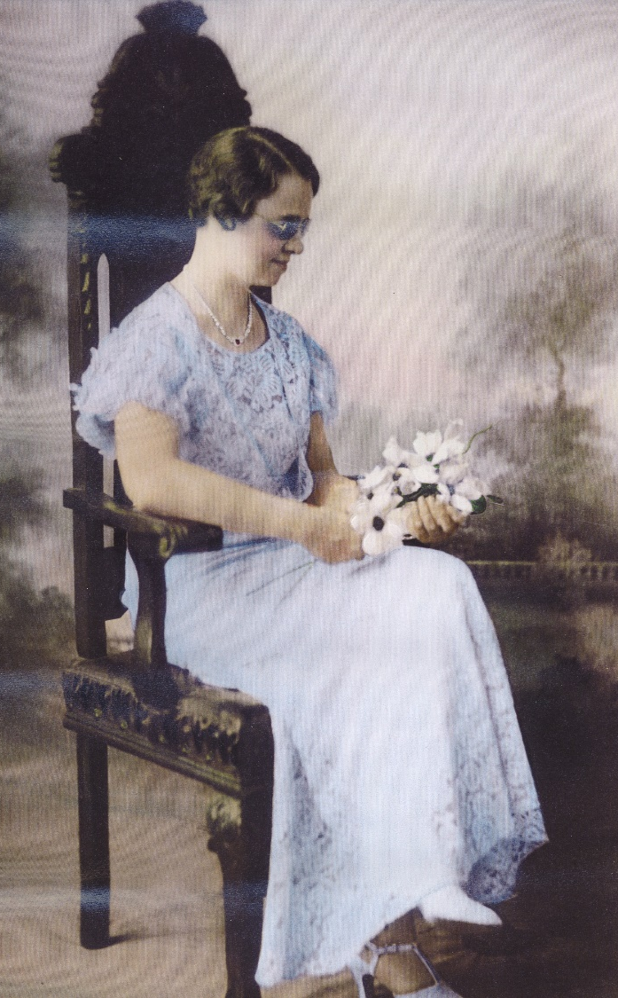
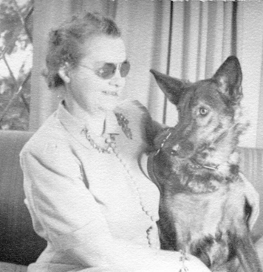
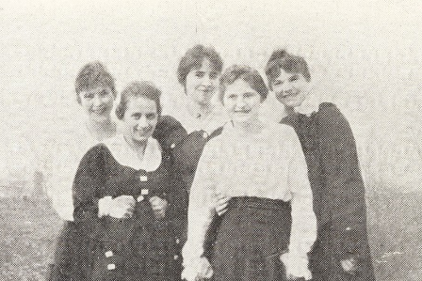
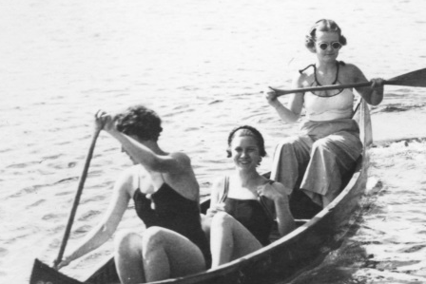
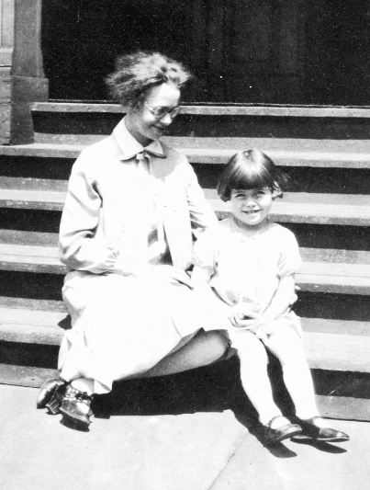
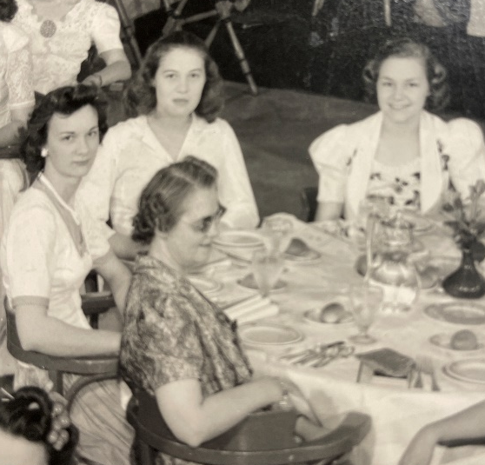
RUTH BILLOW
Eta-Akron
Notes:
SAY: In 1936, Ruth Billow, our own Delta Gamma sister from Eta-Akron asked the Delta Gamma Convention body to adopt “aid to the blind” as Delta Gamma’s official philanthropy and to fund a talking book for people who were blind. The philanthropy name was changed to "Sight Conservation & Aiding the Blind" in 1942, and in 1995, it became "Service for Sight."
Ruth Billow herself was blind and understood the needs of people with low vision, especially children. Since its founding in 1951, the Delta Gamma Foundation has fostered relationships with hundreds of organizations that share our Service for Sight mission.
Within Delta Gamma, doing good for others means hands-on service and Foundation fundraising to benefit Service for Sight all year long. We bring hope to individuals and communities that may not have it by living our do good motto well beyond recruitment by doing good throughout the year.

Slide 12
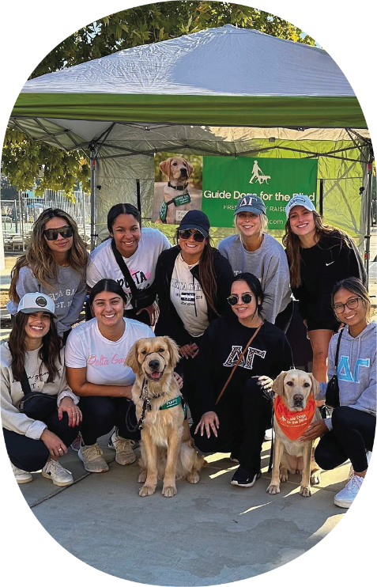
IN WHAT WAYS DOES DELTA GAMMA SUPPORT SERVICE FOR SIGHT?
Notes:
FACILITATOR NOTES: Allow members time to do this individually, as small groups, or in the larger group. They should ultimately identify these four major ways:
SAY: Take a few moments to reflect on Service for Sight and jot down at least four ways that Delta Gamma sisters support Service for Sight across North America.
Five Delta Gamma Schools for Children with Visual Impairments
Service for Sight grants
Do Good: Service for Sight Hours
Fundraising and directed giving for Service for Sight nonprofits

Slide 13
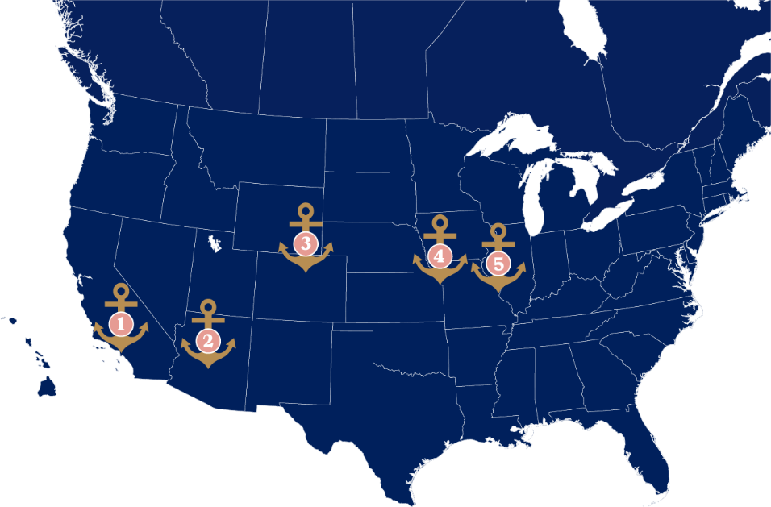
DG SCHOOLS FOR CHILDREN WITH VISUAL IMPAIRMENTS
Blind Children's Center, Los Angeles
Foundation for Blind Children, Phoenix
Anchor Center for Blind Children, Denver
Children's Center for the Visually Impaired, Kansas City
Delta Gamma Center for Children with Visual Impairments, St. Louis
Notes:
SAY: Delta Gammas founded 5 schools across the U.S. for children with visual impairments and continue to serve these schools as leaders and volunteers. The Delta Gamma Foundation, with the support of our fundraising dollars, awards annual grants to the schools to support their operations.
FACILITATOR NOTES: If you would like to show more about each school to your chapter you can click on each school’s name above.
1. Blind Children's Center, Los Angeles
2. Foundation for Blind Children, Phoenix
3. Anchor Center for Blind Children, Denver
4. Children's Center for the Visually Impaired, Kansas City
5. Delta Gamma Center for Children with Visual Impairments, St. Louis

Slide 14
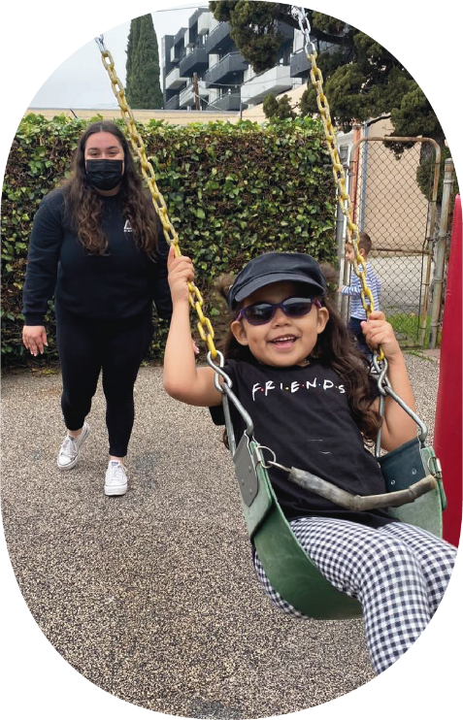
SHARING THE DELTA GAMMA PHILANTHROPY STORY…
Doing good matters – here are some of the people who benefit from our commitment to philanthropy.
Notes:
SAY: We can also talk about the five Delta Gamma Schools for Children with Visual Impairments during recruitment. Our Delta Gamma schools are one way that we live out our do good motto and show our commitment to Service for Sight. These schools serve thousands of children and families each year and help children who are blind or who have low vision get all the opportunities and access as their peers who are sighted.
FACILITATOR NOTES: The next slide provides examples of students from the different Delta Gamma Schools.

Slide 15
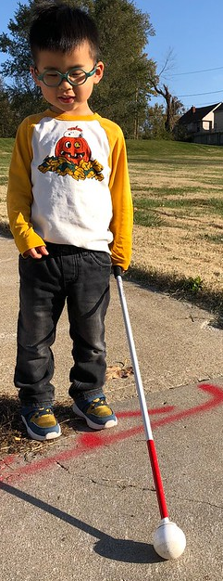
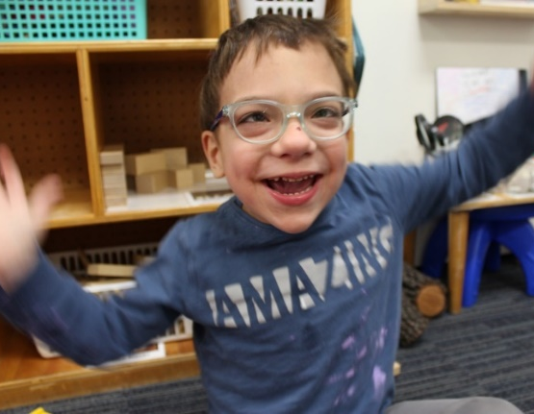
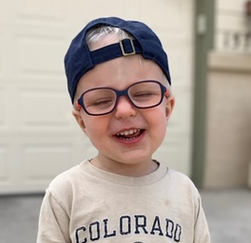
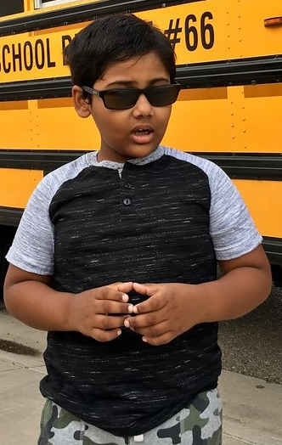
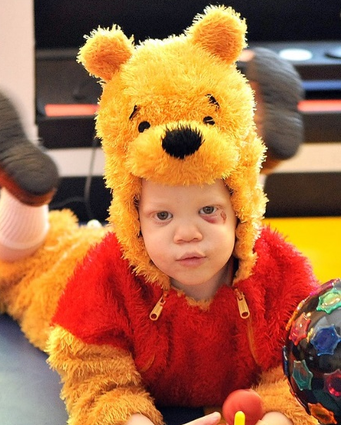
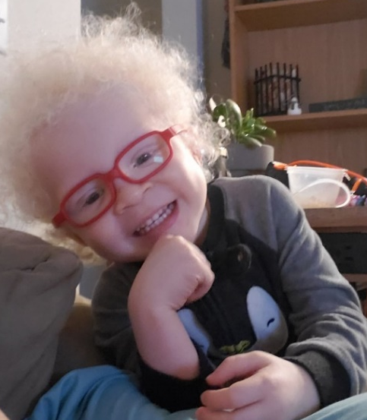
Notes:
SAY: The faces you see here are representative of so many of the people we are serving through Service for Sight, and these are some of the children from the Delta Gamma Schools that have benefitted from the support of members of Delta Gamma. While we as chapter members may not directly volunteer with a Delta Gamma School, we can support them with our chapter fundraising. Our Foundation Service for Sight grants support the students’ development and education.

Slide 16
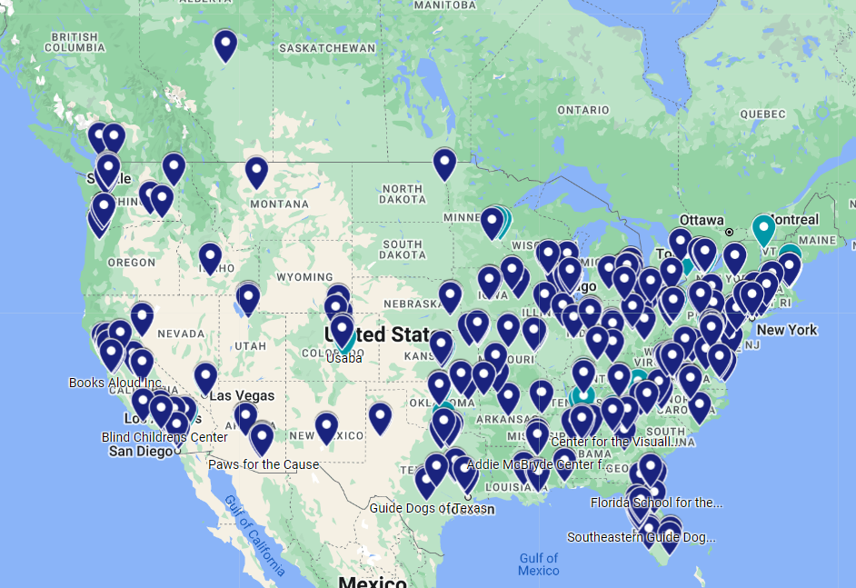
OUR COLLECTIVE SERVICE FOR SIGHT IMPACT.
Notes:
SAY: And beyond the 5 Delta Gamma Schools, Service for Sight grants and collegiate and alumnae service and fundraising support hundreds of local non-profits who share our Service for Sight mission throughout North America. This map shows just some of the organizations that are benefiting from the service and fundraising from Delta Gamma.

Slide 17
LAST YEAR, OUR FOUNDATION…
Awarded over 500 scholarships and fellowships to members
Granted $800,000 to the Fraternity to support Training and Programming initiatives for educational and leadership development
Granted over $700,000 to organizations that share our Service for Sight mission
Notes:
SAY: Our Foundation is a leader in the sorority/fraternity world, and we should be proud of our own philanthropic work as we support our Foundation. Last year, the Foundation granted over $700,000 to non-profits that share our Service for Sight mission, granted over 500 scholarships and fellowships to members, and Granted $800,000 to the Fraternity for Training and Programming.

Slide 18
THIS WAS ALL POSSIBLE BECAUSE…
Close to $5 million was gifted to the Foundation in Fiscal Year 2023-24 by individual donors, alumnae groups and chapter fundraising!
Notes:
SAY: These grants are supported through the dollars fundraised for the Foundation by collegiate chapters and alumnae groups, and the yearly gifts and long-term endowments made by individuals to further the mission of the foundation. Thank you too for making this impact possible!

Slide 19
OUR CHAPTER STORY…
Notes:
FACILITATOR NOTES: This is the introduction slide to the chapter specific slides you will create. The next slide has the template/details for you use to customize based on your own chapter.

Slide 20
HOW DOES OUR CHAPTER SUPPORT DELTA GAMMA’S PHILANTHROPY SERVICE FOR SIGHT?
Notes:
ACTIVITY:
Take 3-4 minutes for individual members to write down 1-2 sentences to answer in their own words this question:
How does our chapter support Delta Gamma’s philanthropy Service for Sight?

Slide 21
HOW [CHAPTER NAME] SUPPORTS SERVICE FOR SIGHT AND THE FOUNDATION:
[Insert Do Good: Service for Sight Hours]
[Insert chapter Signature and Non-Signature fundraisers]
Add photos!!
Notes:
FACILITATOR INSTRUCTIONS: In preparation for this workshop, customize this slide to include the activities your chapter does specifically to support the Delta Gamma Foundation and our philanthropy Service for Sight, such as Do Good: Service for Sight Hours and sample Signature and non-Signature fundraisers. Consider adding several slides here to include pictures and videos from the events and the Service for Sight groups that also benefitted from the fundraisers.
Make sure to include service projects members of the chapter have done for Do Good: Service for Sight (you can find the total number of Do Good Hours to include here in Anchorbase) and how much you raised for each fundraiser (you can find this in Anchorbase on the chapter dashboard or in the Fundraising Finance Report Form or ask your advisers or RFNC). Additionally, include any upcoming planning fundraisers or group service projects that chapter members can discuss with PNMs that they are looking forward to participating in.

Slide 22
WHAT IS OUR COMMUNITY AND HOW DO WE SERVE IT?
Notes:
FACILITATOR INSTRUCTIONS: You will now help chapter members think about who is being impacted by doing good. Who is their community? You can ask participants to use the notes section on their phones, or sticky notes that you hand out and then collect on a surface, or simply have members pair up to discuss and then share with the larger group and compile the answers on a slide or a flip chart. Once the group identifies who the different parts of their community are, ask them to identify how they are doing good in that community as a chapter. Then ask members to identify how they serve those communities individually through either Do Good: Service for Sight or Do Good: Non-Service for Sight.
ACTIVITY:
Instruct the group to discuss and then write down all the various groups that are part of their community- this could be campus groups, other Panhellenic groups, service for sight organizations, the local community, etc. Collect these responses.
Instruct the group to think about how their Delta Gamma chapter serves this community. Collect these responses and discuss.
Instruct the group to think about how they serve this community individually, through Do Good: Service for Sight and Do Good: Non-service for Sight hours. Collect Responses and discuss.
Say: We are an active part of our community in multiple ways. Service for Sight is our priority for our service and fundraising, but as members of Delta Gamma, we are always doing good.

Slide 23
WHAT HAVE YOU EXPERIENCED IN SUPPORTING SERVICE FOR SIGHT?
Notes:
FACILITATOR INSTRUCTIONS: Organize everyone into medium size groups. Facilitate this as a discussion within the groups and then share out from those groups to the whole chapter what their favorite service/fundraising activities have been.
SAY: Let’s think about how we share our chapter’s commitment to philanthropy. In your groups, discuss two questions, and then we will share out with the larger group the things that were common and the things new to you that our chapter does with Service for Sight:
What are your favorite service and fundraising activities you’ve done individually or with our chapter?
Why is this work necessary, and why are you interested in working with this organization?

Slide 24
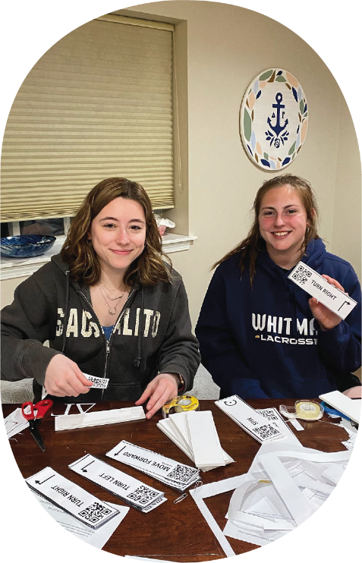
TELLING YOUR CHAPTER’S DO GOOD STORY…
Notes:
FACILITATOR NOTES: Brainstorm some ideas from the group and collect them on a flipchart or blank ppt slide to identify common themes heard from chapter members. The next slide has some suggestions for highlighting the chapter activities during recruitment.
SAY: Based on the experiences we just shared in the larger group, let’s now think about how we can share this with potential new members during recruitment.
What have you experienced in your chapter that you could share to tell your do good story with potential new members?
What are some new and creative ways that we can share our chapter’s philanthropy story during recruitment, particularly our relationship with local Service for Sight organization or Delta Gamma schools?

Slide 25
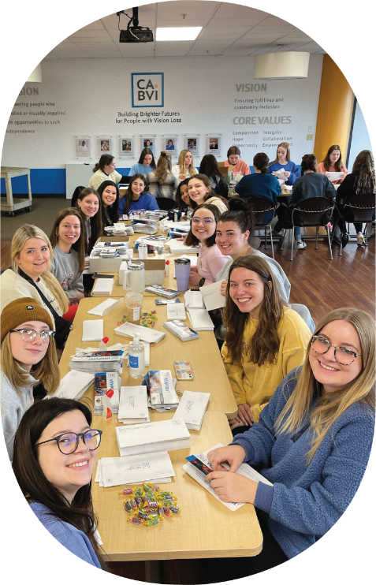
GREAT IDEAS!
What are ways we can highlight Delta Gamma’s philanthropy during recruitment?
Stories, pictures and quotes from an organization you support*
Invite an organization you support to make a short video about their experience*
Make stickers/buttons with pictures guide dogs (if you’ve worked with guide dog organizations) that can be worn during recruitment*
Print posters/pictures or share online activities of the organization(s) you support*
Print posters and pictures (or share online) of Delta Gamma schools and their students*
Create audio messages to share with students at DG schools*
Share social media videos of guide dog training/usage or influencers who are blind or have low vision*
Any other ideas that will inspire potential new members!
(asterisk indicates virtual possibilities)
Notes:
ACTIVITY- Have members popcorn ideas and discuss in the large group some ways they can highlight activities members do in support of the Delta Gamma Foundation during recruitment. As members share ideas record them (white them on a big wall sticky note or on computer slide/doc) for the whole chapter to observe.
NOTE: When you click on the slide a second time a list of general ideas will appear to assist in the idea facilitation if needed.

Slide 26
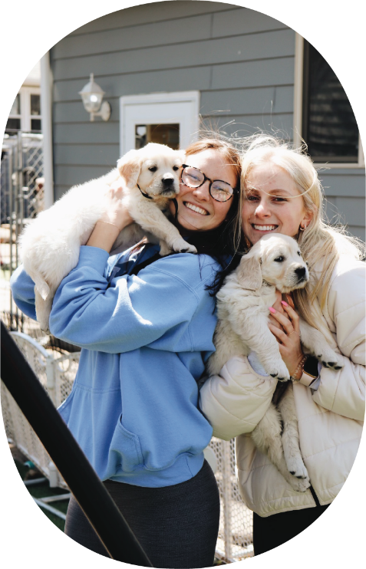
HOW CAN YOU DESCRIBE YOUR EXPERIENCE WITH THE FOUNDATION’S IMPACT IN 30 SECONDS OR LESS?
Notes:
ACTIVITY: Break intro small groups
Take 5-10 minutes for individual members to create a 30-second “elevator pitch” of our Foundation’s impact on individual members, the chapter, and people served through Service for Sight and your specific role within that.
Once the smaller groups have their pitches, ask some or all groups to share with the larger group(s) the elevator pitches about the Foundation’s large-scale impact.

Slide 27
THANK YOU FOR PARTICIPATING TODAY!
Philanthropy is at the
heart of Delta Gamma and our do good motto!
Notes:
SAY: The Foundation helps members be their authentic selves, grow and develop, and do good. We hope you have had a chance to reflect on your own do good story, thought about ways that we can share that story with others, and learned more about how the Foundation supports us as members.

Slide 28
APPENDIX

Slide 29
FACILITATOR RESOURCES
Social Media influencers to include in this presentation or share with the chapter to connect to those we help support through Service for Sight:
Molly Burke | https://www.facebook.com/MollyBurkeOfficial https://www.youtube.com/@MollyBurkeOfficial
Lucy Edwards | https://www.facebook.com/lucyedwardsofficial https://www.youtube.com/@lucyedwards
Aaron Reistad | @aaronreistad
Zoey the Seeing Eye Dog | https://www.facebook.com/zoetheseeingeyedog
Bold Blind Beauty | @boldblindbeauty
How Casey Sees It (Casey G) | https://www.youtube.com/@HowCaseySeesIt
DG Gena Harper | @genablindwomanofaction
Guide Dogs for the Blind | https://www.facebook.com/guidedogsfortheblind
The Blind Life | https://www.facebook.com/theblindlifesam https://www.youtube.com/channel/UCNbzN3eHbLKPzltSB560DkA
Blind to Billionaire | https://www.facebook.com/groups/282915199014325 https://www.youtube.com/channel/UCYqOP98j1cPqLzN2-AAgsHQ
Notes:
FACILITATOR RESOURCES:
You may want to do the Foundation Ceremony- Do Good Foundation Ritual as a part of the session. You can find the ritual linked below from the Delta Gamma Library.
Foundation Ceremony- Do Good Foundation Ritual

Slide 30
FACILITATOR RESOURCES
Possible hands-on activities for the philanthropy round:
NOTE: Please be sure to reach out to the organization you hope to support with these ideas BEFORE the activity to ensure the organization can receive and wants the physical items before donating them.
Create scented dough or clay for elementary schools or daycares to have inclusive dough for students
Assemble cane identifiers to be given to schools for blind or visually impaired organizations (beaded chains with letters that you can feel or specific charms)
Create guide dog chew toys out of old fabric to be given to a guide dog organization (T-shirts, pants, sheets, etc.)
Make dog blankets for Guide Dog organizations
Make tactile eggs to give to organizations hosting egg hunts in the spring to make the hunts more inclusive
Design and make beaded eyeglass lanyards
Notes:
-Create scented playdough for elementary schools or daycares to have inclusive playdough for students (video on how to make: https://www.youtube.com/watch?v=EdraObo-23c)
-Assemble cane identifiers to be given to schools for blind or visually impaired organizations (beaded chains with letters that you can feel or specific charms)
-Create guide dog chew toys out of old fabric to be given to a guide dog organization (t-shirts, pants, sheets, etc.)
-Make Dog blankets for Guide Dog organizations ( video example: https://www.youtube.com/watch?v=Xuf3F_2VE8M)
-Make tactile eggs to give to organizations hosting egg hunts in the spring to make the hunts more inclusive (examples: https://www.wonderbaby.org/articles/best-tactile-easter-crafts-internet)
-Design and make beaded eyeglass lanyards (examples: https://www.readers.com/blog/glasses/diy-reading-glasses-chain/ https://feltmagnet.com/crafts/beaded-convertible-eyeglasses-leash-necklace)

Slide 31
QUIZ TIME!
How long has Delta Gamma supported Service for Sight?
150 years
88 years
50 years
33 years
Notes:
SAY: Time for a quiz and to see everyone’s historical knowledge of Service for Sight. How long as Delta Gamma supported Service for Sight?
FACILITATOR NOTES: The correct answer is B. Can be added before slide 10 in the deck
Optional explanation:
In 1936, Ruth Billow, our own Delta Gamma sister from Eta chapter-Akron asked the Delta Gamma Convention body to adopt “aiding the blind” as Delta Gamma’s official philanthropy and to fund a talking book for the visually impaired. The philanthropy name was changed to "Sight Conservation & Aiding the Blind" in 1942, and in 1995, it became "Service for Sight." Ruth Billow herself was blind and knew first-hand the needs of those in the blind and visually impaired community, particularly children. Since its founding in 1951, the Delta Gamma Foundation has fostered relationships with hundreds of organizations that provide access and advocacy for those in the blind and visually impaired community.
Within Delta Gamma, Doing Good for others means hands-on service and Foundation fundraising to benefit Service for Sight all year long. We bring hope to individuals and communities that may not have it by living our Do Good moto well beyond recruitment by Doing Good throughout the year.

