Slide 1
CHAPTER FINANCE ADVISER (CFA)
Notes:
(Session time: 2 Hours)
Facilitation Key:
Total Time: XX | Marks the amount of time the section/slide should take to complete.
Fac Note | Highlights special instructions for you as the facilitator.
Italics | Marks statements or questions that you should say out loud.
Plain Text | Indicates instructions for you.

Slide 2
Introductions
Share…
Name
Chapter of Initiation
Chapter you advise
Your why
What do you hope to get out of today?
Notes:
(5 minutes)
Welcome to the CFA track at Adviser Training Academy! Thank you again for being here – it is my hope that we cover information today that gives you the confidence you need to coach the vp: finance toward financial well-being for her chapter!
Introduce yourself.
We are going to start with introductions before we dive-in to position responsibilities. Let’s have each person share their name, chapter of initiation and the chapter you advise, tell us why you choose to be an adviser and one thing that you hope to get out of today’s training.
Let each adviser introduce themselves. This can be done by asking each participant to unmute themselves or by asking each participant to type their introduction into the chat box. If there are more than 15 participants, the chat box is recommended due to time constraint.
Great – thank you!

Slide 3
Agenda
Financial record keeping for collegiate chapters
Delinquent Report Spreadsheet
Greekbill management
Managing New Members
Contracts in greekbill
Receivables
Member survey
Wrap up & resources
Notes:
(2 minutes)
Here is our agenda for the day.
Fac Note: It may be helpful to keep a list to use as a “parking lot.” Keep this parking lot as a reminder of the questions that have come up in the group that may not pertain to the material being presented/presented currently, but could be answered if there is additional time at the conclusion of the presentation.

Slide 4
FINANCIAL RECORD KEEPING
Notes:
Brief intro

Slide 5
Check Writing 101
Before you write a check:
Review the invoice
Request a W9 if applicable
If amount is over $500, second signature required (chapter president)
Notes:
1 minute
Before an officer writes a check or makes a payment. Coach them to getting in the habit of stopping and doing these 3 things:
Review the invoice or order confirmation: if the payment is for a vendor for something, you should receive an order invoice. Review the invoice to ensure that the expense is budgeted for
If the check amount exceeds $750 OR if you plan to work with the vendor an alternate time throughout the year, you must request a copy of their W9 form for tax purposes. Note: W9 forms are NOT required for payments made to utility companies or your university
If the check amount exceeds $500, you will need a second signature from the chapter president or adviser listed on the chapter bank account

Slide 6
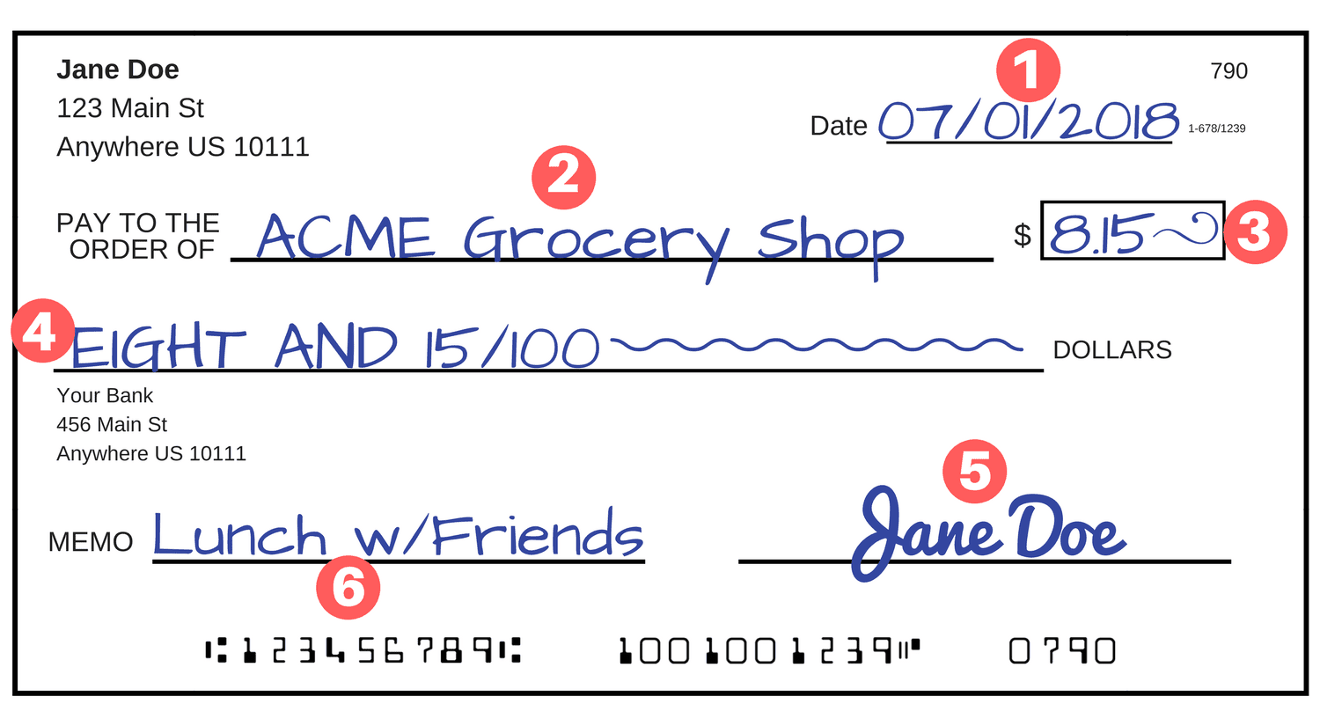
Check Writing 101
7
Notes:
(3 min)
For many of our collegiate officers, serving as vp: finance may be the first time they ever use a checkbook! The chapter should have it’s own chapter checkbook. The vp: finance you are responsible for upkeep and maintaining the chapter check book in a secure place. However, because this process may be new to them, they may turn to you for guidance on how to use a checkbook properly.
This slide and image includes steps that may be helpful to review with them.
Let’s review the steps of writing a check:
In the date field, you will write the date you are writing the check to pay the expense
The “Pay to the Order” line is where you will write who the check is being made out to. This is where you would put the vendor name for payment to a vendor OR the name of the member you are reimbursing
You will write the numeric value of the dollar amount for the check in spot #3.
In step 4, you will write out the dollar amount for the check. The squiggle line here is to fill up the full line, so that no additional amounts could be added. Something to note here – you must always fill out a check’s amount. Blank checks are never permitted
Step 5 is where you will sign. As vp: finance, you should have gained access as a signer on your chapter bank account during transitions. This gives you authority to sign for check purchases. If the check is for over $500 OR if you are reimbursing yourself, the check also requires the signature from the chapter president or adviser listed on the chapter bank account
The memo section of the check is where you can put a description of the purchase. This is helpful for record keeping and to remember what a purchase was for and where it should be allocated on greekbill. Examples of memos could be: Bus rentals for Crush Party, stoles for seniors, bid day t-shirts for new members.
Do you see the small number next to step 7? This is the check number. In this example, we are looking at check number 790. When you code a check into greekbill and it asks for a check number this is what it is referring to. You will also see these check numbers on your monthly bank statement.

Slide 7
Purchase Cards
Can be ordered for officers via greekbill
Must be ordered in the officer’s name
Expectations should be discussed with each Pcard holder and an officer budget contract must be signed
Funds are loaded onto Pcards
Receipts required for all purchases
Card holders are responsible for all purchases made on the card
Notes:
(3 min)
Purchase cards are a great option for payment use when an officer has a need to make multiple payments throughout their term.
Here are some important tips to remember before officers begin using purchase cards :
Purchase cards must be ordered in greekbill. There is a $5 fee for each card
Purchase cards are in the name of the individual officer. Officers should NOT share cards
Purchase card expectations are outlined in the officer budget contract that all officers must sign in greekbill
Pcard purchases are for approved Delta Gamma business only
Officers must continue to spend within their approved budget while using a pcard. If an expense is expected to go over budget, the officer must receive approval to make the purchase prior to spending
Officers must turn in copies of receipts to the vp: finance after making pcard purchases
Pcard purchases do NOT require a W9

Slide 8
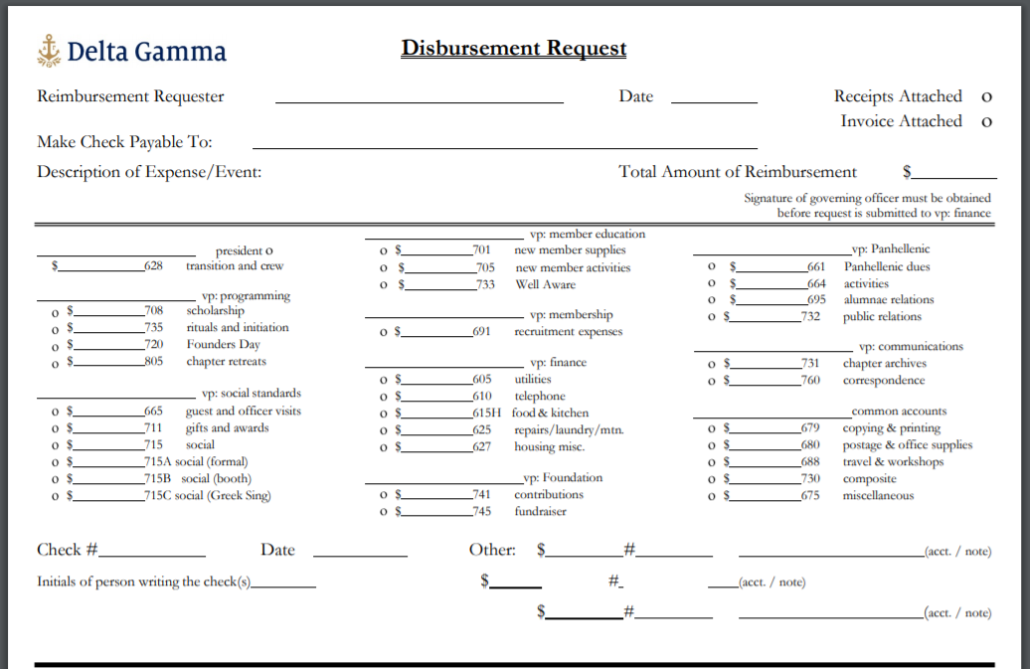
REIMBURSEMENTS
Notes:
(1 min)
Sometimes officers may make purchases using personal funds. Reimbursements can be made to members only when the purchase was previously approved and is related to DG business.
To receive a reimbursement, the member must complete the disbursement request form (found in DG Library) and submit to vp: finance with all receipts
Disbursement forms and receipts are due to the vp: finance within 2 weeks of the purchase being made

Slide 9
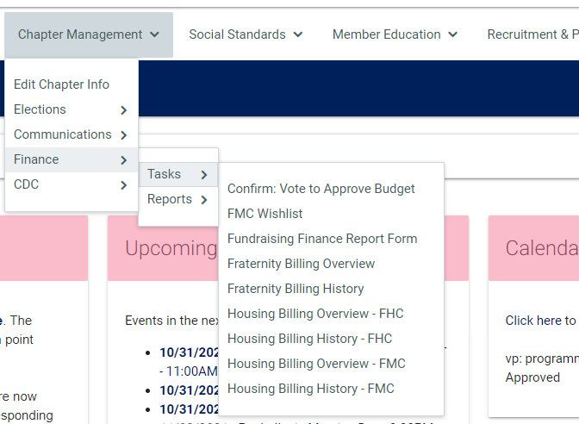
ACH
Notes:
(2 min)
The final payment method the chapter will use is through ACH – this is an automatic withdrawal of funds from your chapter bank account. This is how the chapter will pay payments to Executive Offices for relevant fees and to pay fees to House Corporation or FMC.
These payments will be automatically withdrawn from the chapter bank account, but will still need to be entered into greekbill. You can view ACH payments that have been processed in Anchorbase. The Screenshot on this slide shows how to find these.
- Select “Fraternity Billing History” to view all payments that have been withdrawn to Executive Offices” and select “Housing Billing History – FHC” or “Housing Billing History – FMC”. Use this information to enter these payments as a “check” expense in greekbill.

Slide 10
Chapter Bank Account
Each chapter has their own chapter bank account
Ensure necessary officers (chapter president, vp: finance, CFA) have access to the account and are listed as a signer
Secure online bank access
Ensure new officers are added to the account following elections
Notes:
2 minutes
As CFA, you play a helpful role in guiding the chapter officers when it comes to their chapter bank account. For some of our vp: finances, working with the bank may seem overwhelming. These are some steps to help remember
Review slide

Slide 11
Chapter Bank Account
The vp: finance submits monthly bank statements to Collegiate Finance at EO monthly. Bank statements are due on the 10th of the month
Transactions entered in greekbill should match what is reflected on the bank statement
Collegiate Finance will reconcile and send a report
Notes:
2 minutes
Review slide
Ensuring that you and the vp: finance have online banking access is helpful in turning in monthly bank statements on time. These will be used for reconciling and to ensure that all transactions have been entered into greekbill accordingly.

Slide 12
Receipt and Invoice Files
Filed hard copies in a binder or folder OR create a digital record
Maintains a record and paper trail
Validates how chapter funds were spent
Keep for 7 years
Notes:
(1 min)
The vp: finance is tasked with ensuring that documentation of payments is recorded and kept for safe keeping. These are Delta Gamma’s expectations:
All receipts and invoices should be filed in hard copy in a biner or folder OR you should create a digital record
This maintains a record and a paper trail and validates how your chapter funds were spent
These records should be kept for 7 years

Slide 13
Greekbill = Financial Record
All checks are entered into greekbill
Expenses are coded to the relevant account
Purchase card expenses are categorized
Profit loss report or account detail report can be used to view where items have been coded to
vp: finance submits monthly greekbill report by the 10th of the month once all transactions are recorded appropriately
Notes:
(3 min)
The chapter bank account is where all “real” money is. Greekbill is a system we use to keep track of spending and to get a quick understanding of the chapter’s financial status.
All checks should be entered into greekbill after they are written. When a check is entered, the vp: finance also selects the greekbill account the expense it should be coded to. These accounts are connected to the chapter’s budget. For example, if you are entering a check that covered expenses for a sisterhood account, you would select account 805 in greekbill. Have questions about where an expense should be allocated to? Review the Chart of Accounts in the Collegiate Finance Handbook
Pcard expenses are automatically entered into greekbill but must be categorized to place the expenses in the relevant expense accounts. Until a purchase card expense is recategorized, it will default to an uncategorized account.
After an expense has been entered into greekbill, you can view it along with all other coded expenses by using the Profit Loss report or Account Detail report. We will share more information about greekbill and purchase cards today shortly.
In addition to submitting the monthly bank statement, the vp: finance also submits a monthly greekbill report. Submitting this report verifies that all transactions have been entered and coded correctly in greekbill. Work with your vp: finance to review the report before it is submitted to Collegiate Finance.

Slide 14
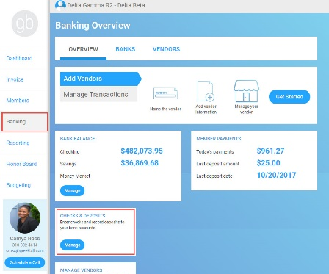
BANKING – CHECKS & DEPOSITS
Notes:
(3 minutes)
In greekbill, you can monitor what checks have been written and monitor the reimbursements being given by the vp: finance.
Navigate to the checks and deposits screen in greekbill. What do you see that is helpful information?
How might you utilize this report on a weekly or monthly basis? (tell participants to unmute themselves and share!)
Listen for:
Checks and balances to be sure the vp: finance is writing checks and spending funds appropriately and that reimbursements are being done in a timely manner
Monitor budget and encourage adjustments, if needed
Make sure memo section is being utilized for both checks/deposits/ACH payments and that the memo gives a good explanation for the payment/deposit
Look at how checks are coded – are they being coded to the correct expense accounts?
If CFA doesn’t see checks or coding, she should work with vp: finance because those things inform other reports in greekbill
Be sure that receipts have been received prior to reimbursements being made.

Slide 15
DELINQUENT REPORT SPREADSEHET (DRS)
Notes:
1 minute
In the last section, we discussed all the things necessary to ensure that chapters are maintaining good financial record keeping. As we discussed, part of that process is ensuring that Collegiate Finance can reconcile bank statements for our chapters through submitting monthly bank statements and greekbill reports. But what happens if chapters are not submitting this documentation appropriately?
That’s when the Delinquent Report Spreadsheet comes in. Let’s take a look !

Slide 16
Notes:
(4 minutes)
The DRS is updated each Thursday and uploaded to the Library. It is also sent out via email on the 15th and the 31st of each month. What is shown on this screen is a copy of the DRS, but it isn’t the most updated one! You will find that one in the Library.
Allow the CFAs to sign in to the Library and to find the report. It is called “Delinquent Report Spreadsheet.”
You can see that all chapters are listed here with columns that correspond with items/funds due to the Fraternity or Office of Housing. There is also contact information for each item if the chapter has questions related to anything they see on the spreadsheet.
We recommend you get in the habit of checking the DRS twice a month – a great practice is to open up the email each time you receive it to take a quick look. Encourage the vp: finance to reach out to the appropriate person should any questions arise. This also serves as a good checks and balances system so you can be sure the chapter is current and has submitted payment in a timely manner. If the chapter you advise is ever listed, it is a good idea to then check in with the vp: finance. PPD points are lost if a chapter is listed on the DRS for more than one week, so it is important for the chapter to clear up any issues.
What questions do you have about the DRS? Feel free to raise your hand or pop your questions into the chat box for us to answer.
Answer any questions that arise from the advisers.

Slide 17
W9 Forms
Collected prior to contracts being signed
Collected prior to payment to vendors
EO Contact: Chelsea.simko@deltagamma.org
Notes:
(1 minute)
One item you will see on the Delinquent Report Spreadsheet is the collection of W9s the chapter needs.
The chapter must obtain a w9 for certain vendors that they pay over $750/year. This is an IRS obligation. The W9 should be secured BEFORE the vendor is paid, unfortunately this is not always done. The accounting team at Executive Offices goes through checks paid to vendors twice a year and checks for W9s, then contacts chapters if anything is missing. If a chapter is audited, they could be fined for each missing W9. So, if a chapter is listed for a missing w9, the CFA should contact Chelsea for more information on the missing vendor. Many times the vendors do not work well with the students, but they trust advisers a bit more!
Do you have any questions about W9s?
Take any questions that arise before moving on.

Slide 18
GREEKBILL MANAGEMENT
Notes:
Brief intro

Slide 19
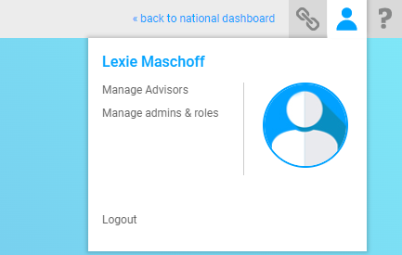
GREEKBILL MANAGEMENT & SUPPORT
greekbill Reps
cross@greekbill.com (Region 1, 2, &5)
jweisbaum@greekbill.com (Region 3, 4 & 7)
jclark@greekbill.com (Region 6 &8)
Notes:
(1 minute)
It is imperative that all members of the finance team have access to greekbill. As new chapter officers are elected, you should work with them to ensure that they have access to greekbill.
You can confirm which officers have admin access to the chapter’s greekbill account by selecting the person icon in the upper right hand corner.
If you have questions or need assistance with greekbill access or the system in general – contact your assigned greekbill representative. These are greekbill staff members who support our chapters by each region. Their contacts are listed on the slide.

Slide 20
CFA Favorites on Greekbill
Member Summary – what is owed, individual member billing history and copies of monthly statements
Unsecured Receivables-DG – debt of members who haven’t signed Dues and Fees contracts - unsecured receivables limit is 5% chapter membership and % shows here.
Last Report Submitted – shows the last report vp: finance submitted on GB
Check and Deposit Reports – lists all checks/deposits entered in greekbill by vp: finance; may be manipulated to be in date/ check number/vendor order; once report submitted, only CF can make adjustments
Notes:
(5 minutes)
Give participants 5 minutes to explore this list, then go on to the next.

Slide 21
Favorites cont.
View Budget- place to see current year or past year approved budget
Account Detail – wonderful place to audit spending on a particular account
Profit/Loss vs. Actual – gives actual spending vs. budget at any point in time
Add/View Edit Contracts – report to confirm contracts other than D&Fs have been assigned for online signatures
View Signed Contracts – place to see numbers of members have signed/unsigned contracts
Payment Schedule & Contract – under Budget Builder; shows roster with dates of signature of D&Fs; can pull for unsigned
Notes:
(5 minutes)
Give participants 5 minutes to explore this list, then go on to the next.

Slide 22
MANAGE NEW MEMBERS
Notes:
1 minute
Up until now, we have discussed ways that CFAs can monitor and support the vp: finance in ensuring that good financial record keeping is occurring. We will now transition to discuss other operations that the finance team will perform that impacts how the general chapter membership interacts with finances and greekbill.
Raise your hand if the chapter you work with participates in fall recruitment? Great! As we welcome new members to our sisterhood, it is important that we help the chapter ensure that these members have access to greekbill to pay their dues.

Slide 23
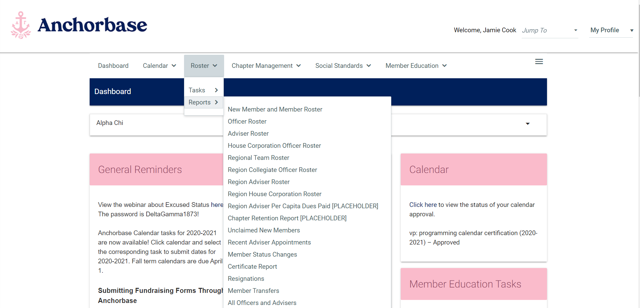
ADDING NEW MEMBERS
Notes:
(1 minute)
In order to bill a member on greekbill, that member must exist on the chapter roster in Anchorbase.
After the chapter you work with participates in recruitment, the recruitment and member education team should be adding those new members into Anchorbase. Once new members are added into Anchorbase, the system will synch with greekbill to add them to the greekbill roster.

Slide 24
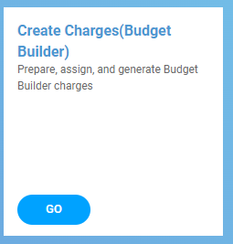
BILLING NEW MEMBERS
Select billing group
Select members
Submit and assign charges
RCS approval
Notes:
(5 minute)
Once a new member populates on the greekbill roster, the vp: finance must assign them charges in greekbill. This is done through the “Budgeting” tab and by selecting the “Create Charges” tile.
The vp: finance will assign charges by following these steps:
Select the billing group they wish to assign. For new members who join in the fall this would be: Fall New Member/Spring Member
Select all members they wish to assign charges to
Push the submit and assign charges buttons
After charges are submitted, your chapter’s RCS will be notified. The RCS will review and approve generated charges and the new members will be billed.
Allow time for participants to review greekbill and ask any questions about this process

Slide 25
CONTRACTS
Notes:
1 minute
There are a handful of contracts that the finance team will issue to ensure that members follow through with financial responsibilities to the chapter. Today we are going to discuss two types of contracts that CFAs should be aware of for the fall term.

Slide 26
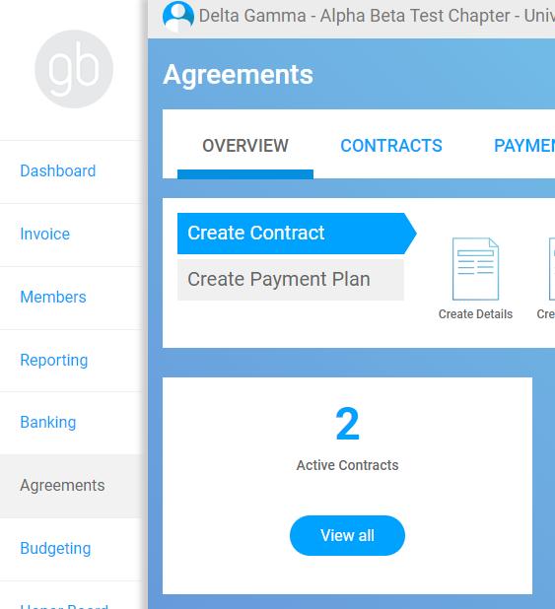
Contracts in greekbill
Notes:
1 minute
Contracts can be viewed in greekbill by navigating to the Agreements tab and selecting the “View All” button.
The templates of contracts will be uploaded into greekbill each year for you. It is the vp: finance’s responsibility to assign these contracts to all relevant members and ensure that they are signed within 10 days. If a contract is not signed within that time period, an APN is issued.
When a contract is assigned to a member, they will be prompted to sign it upon logging into their greekbill account.

Slide 27
Officer Budget Contract
An officer budget contract should be assigned to all current chapter officers
This contract sets the expectation that officers are responsible for spending only funds that are budgeted for
Tip: How can you encourage your vp: finance to ensure all officers are aware of the funds that are available for them to spend?
Notes:
3 minute
The first agreement assigned in greekbill that we will discuss is the officer budget contract. This template is loaded into greekbill for the vp: finance and should be assigned to all officers.
Telling the officers that they have a budget at the beginning of the term is just one step. Does anyone have any thoughts or suggestions for how you might advise the vp: finance you work with to ensure that all officers are aware of the funds they have available to spend?
Allow for people to unmute or share answers in the chat.

Slide 28
Room Agreements
Assigned in greekbill to members who will live in the chapter facility
Should be assigned and signed by members in October (the academic year before the member will move in)
Half-year room agreements are available by request for members who will “share” a contract
Notes:
5 minute
Raise your hand if the chapter you work with has a live-in housing facility? Great!
Room Agreements (RAs) are an important contract that establishes the relationship between the member, chapter, and house corporation. It is similar to signing a lease or expresses the member’s intent to live in the chapter facility.
It may seem odd since it is just the beginning of a new academic year, but NOW is the time to start working with your chapters to assign room agreements.
Room Agreements are assigned in greekbill in the same place that Officer Budget Contracts are assigned. The Room Agreement relevant to the chapter you work with is loaded into greekbill for you – all the vp: finance needs to do is assign it to the members who will be living in the chapter facility.
Sometimes, members may “share” an RA contract for the year. This is a great option if there are members who are planning to study abroad – one member can sign for the fall and another for the spring semester. Half year RAs are available by request through the RCS.
Allow time for questions related to RAs

Slide 29
PAST DUE RECEIVABLES
Notes:
Brief intro
Next is past due receivables.

Slide 30
Past Due Receivables Report
APN – 11-30 days
SOR – 31-45 days
45 Day Letter – 46-90 days
Collections – 61-90 days
90+ Days Past Due – 91 or more days
Notes:
(10 minutes)
Note: if there are any CFAs without greekbill access, it might be helpful to share your screen with greekbill pulled up to show how to access all reports mentioned.
The report on the screen is the Past Due Receivables report in greekbill. This report shows members who are late on their payments.
Go ahead and login to greekbill. Can anyone tell the group how to navigate to find this report?
Answer: login>Reporting tab>past due receivables. Make sure everyone is able to access this report.
This report shows you how much each member owes to the chapter and what should happen at each step of a late payment.
Invoices are due on the first of the month and funds must be in the members greekbill account no later than the 10th of the month.
The headers starting with APN indicate the action that needs taken according to how late the payment is.
Let’s take a quiz. On a piece of paper jot down the column headers starting at APN through 90+days past due. So, the columns are: APN, SOR, 45 Day letter, Collections, and 90+ Days Past Due. For each step, guess how many days past due a member would have to be for that action to take place. I will give you a few minutes to work on this.
After a few minutes, ask the advisers to share their answers and supplement with the correct answers as follows:
APN – 11-30 days
SOR – 31-45 days
45 Day Letter – 46-90 days
Collections – 61-90 days
90+ Days Past Due – 91 or more days
Fac Note: Click enter for the correct responses to appear
This report should be viewed on a monthly basis. You can change the date to view past reports and can also export it if you prefer to view in a different format.
Let’s spend just a couple of minutes in breakout rooms so that you can brainstorm together any questions you have after viewing your own report. When you come back, I’ll ask you to put any questions you have into the chat box.
(Zoom feature: send everyone to their breakout spaces (same as before) for 3 minutes).
When breakout rooms close, prompt the CFAs to include any questions they have inside of the chat box. If the questions can be answered quickly, answer them in the moment. If not, tell them you will come back to their questions.

Slide 31
What if members won’t pay?
Day 1: Invoices are due with a 10-day grace period
Day 11 :
APN sent through greekbill
Member is on probation until payment is up to date*
SOR sent to new members via email
vp: finance meets with Honor Board to go over all members on probation for finance
Notes:
(2 minutes)
There will be a time when the vp: finance has tried to get a member to pay who has not, for whatever reason. As CFAs, you can coach the vp: finance through the steps to follow in this situation.
Day 1 –
Invoices are due on the first of the month with a ten day grace period.
Day 11 –
APN must be sent to members who did not pay by the deadline of the 10th through the Honor Board module in greekbill, which we will talk more about in a few minutes. Please note that any agreements that Honor Board has with the member should supersede this step. If a member has worked out a plan with Honor Board for flexibility in her payment schedule or has been approved for Excused Status, the APN should not be sent. We will talk more about this but we really want to encourage a collaborative relationship between the vp: finance, Honor Board and our members. Now it is more important than ever that we help when we can.
After the APN is sent, the member is on probation until the account payments are up-to-date (note – this is a change this year. As soon as the member is up-to-date on her payment, her probation ends.)
At this point, a SOR is sent to any new members that are past due via email. New members cannot receive APNs. It can be noted in the Honor Board module that a SOR was filed instead of an APN.
The vp: finance should touch base with Honor Board to go over all members that are on probation for finance so that all are on the same page.
Note: the actual APN/SOR process will be discussed later on today.

Slide 32
What if members won’t pay?
Day 30
SOR filed by vp: finance
Vp: social standards must actually send the SOR
Member is still on probation
If a new member still has not paid, discuss with Honor Board to make sure the new member is not approved for initiation
Notes:
(1 minutes)
Day 30 –
SOR filed by the vp: finance for those members who received APNs and still have not paid through the Honor Board module in greekbill. Please note that any agreements that Honor Board has with the member should supersede this step. If a member has worked out a plan with Honor Board for flexibility in her payment schedule or has been approved for Excused Status, the APN should not be sent.
Note that the vp: social standards must actually “send” the SOR through the Honor Board module in greekbill.
Member still on probation and a formal hearing should be held by Honor Board.
Honor Board should hold the formal hearing, even if member does not show up.
If a new member still has not paid, discuss with Honor Board and make sure the new member is not approved for initiation.
Along this entire process, members should be encouraged to reach out and personally check-in with members who are refusing to pay. We have a process to follow, but first we want to demonstrate care and compassion!

Slide 33
What if members won’t pay?
Day 45
A letter should be sent to members who received APNs and SORs
Still on probation
Meet with Honor Board to discuss these members
If a new member still has not paid, they cannot be initiated
Day 60
Discuss with Honor Board
Still on probation
Ask the right questions
Up to Honor Board to begin the expulsion process
Notes:
(5 minutes)
If the member still has not paid and is 45 or 60 days past due, here is how the process continues.
Day 45 –
A 45-day financial review expulsion letter should be sent to members who received APNs and SORs if they still have not paid by the 45th day after the invoice was due. You can find a template of this letter in the Library. It mentions that the member needs to pay the past due balance, that they should meet with Honor Board to discuss their options and lets them know that the chapter could recommend them for financial expulsion.
These members are still on probation.
Vp: finance should meet with Honor Board to discuss these members.
If a new member has gotten to this point and still has not paid they CANNOT be initiated.
Day 60 –
If after sending the APN, SOR, and letter, a member still has not paid, discuss this with Honor Board
Make sure Honor Board has copies of the APN, SOR and letter.
These members are still on probation.
Be sure we are asking the right questions of the member: Are these members on campus? Are these members in the process of resigning? If so, where is the paperwork? Have these members been attending anchored events? Have they received an APN for attendance? In many cases, members who have not paid for two months, didn’t return to campus and no one has followed up with them!
At this point, it is up to Honor Board to begin the expulsion process, although expulsion may not be approved by Council until the member is 120 days past due, the member should be aware that expulsion is a possibility. But….if the vp: finance has not done the steps outlined here, expulsion will not be granted.
At this time Honor Board should discuss if they will do Bad Debt Write Off or send the member to Collections. We will talk more about this later today!
What questions do you have about this process? Feel free to raise your hand or type us a question in the chat box.
Take any questions that arise.

Slide 34
UNSECURED RECEIVABLES
Notes:
(1 minute)
Let’s navigate to the unsecured receivables report in the same way we did for the past due receivables. Reports>Unsecured Receivables

Slide 35
Notes:
(1 minute)
Be sure that all advisers have found this report in greekbill.
Ask:
What is an unsecured receivable? (Ask advisers to unmute themselves and answer or to put their thoughts in the chat box)
Share the following if not shared by the advisers: it is when a member has not signed her Dues and Fees Contract and therefore we don’t have any way of collecting the money she owes. If a member has paid on an unsigned Dues and Fees contract, that money is not the chapters. The member could at any point retract those payments and the chapter would not have the ability to keep the money paid. If a member has not signed the Dues and Fees contract, we cannot hold her accountable. This is problematic because when we created the budget, we anticipated the chapter would have her income. If not all of the funds are collected, then the budget may have to be adjusted because there is less income.
On the screen is a sample of what the Unsecured Receivables report looks like. So you can see the first member on the screen has $565.50 of unsecured receivable.
On this report you will also see at the top where it says “member actual receivables percentage.” Our goal is to have no members on this list.
Does anyone have questions about this report?

Slide 36
COLLECTIONS & BAD DEBT WRIITE OFF (BDWO)
Notes:
Brief Intro

Slide 37
Collections Process
The vp: finance notifies collfinance@deltagamma.org they’d like to initiate the collections process
Collegiate Finance submits the debt to the collection agency for formal collections.
Only individuals who are no longer a collegiate member can be sent to collection.
Collection agency sends a letter to the individual informing her of the action and giving her the opportunity to pay before the formal collection process begins.
Notes:
(2 Minutes)
Review the information on the screen.
Only individuals who are no longer collegiate members or individuals who have resigned or been expelled can be sent to collections or have their bad debt written off. The debt must also be greater than $750.
When an individual shows up on the past due receivable report under Collections, ensure that an APN, SOR, and 45 day letter have been sent. It is essential that the vp: finance copy Kelly McAlea(Collegiate Finance Consultant – Kelly@deltagamma.org) onto the e-mailed version of the 45 day letter. This letter will be needed when compiling the necessary information to be sent to the collections agency. Also ensure they are an alumna or are no longer a member, the debt is greater than $750, and that the necessary contracts have been signed (D&F, RA, etc.). If all of these pieces are in place, the vp: finance can now notify EO to begin the collections process. To notify EO to begin this process, they will need to click on Member Collection Form under the Reporting tab.
Fac note: Active Members cannot be sent to collections. The Honor Board process needs to be utilized and the member recommended for expulsion, then collection can be done.

Slide 38
Collections contd.
$150 submission fee collected by Delta Gamma Executive Offices
The amount a woman is sent to collections for is not always the amount that will be paid back to the chapter:
Chapter decides on amount owed (should be the woman’s current balance in greekbill)
Parson Bishop will retain some of the amount paid
After a woman is sent to collections, their account is no longer “Delta Gamma’s”, now belongs to Parson Bishop Service Inc. (PB)
Notes:
(1 minute)
Review the slide.
As CFA, you can advise the vp: finance when working with Honor Board on whether or not it is a good idea to send the member through the collections process. This is ultimately an Honor Board decision. $750 is used as a cut off – if the amount owed is less than that, the chapter won’t recuperate the costs. It immediately costs $150 to start the process, the collection agency will keep 50% of what is collected and if it goes to court, there is also the potential of legal fees.
Note that once a woman is formally submitted to collections the chapter should not have any contact with her, only Parson Bishop should be talking to the individual.

Slide 39
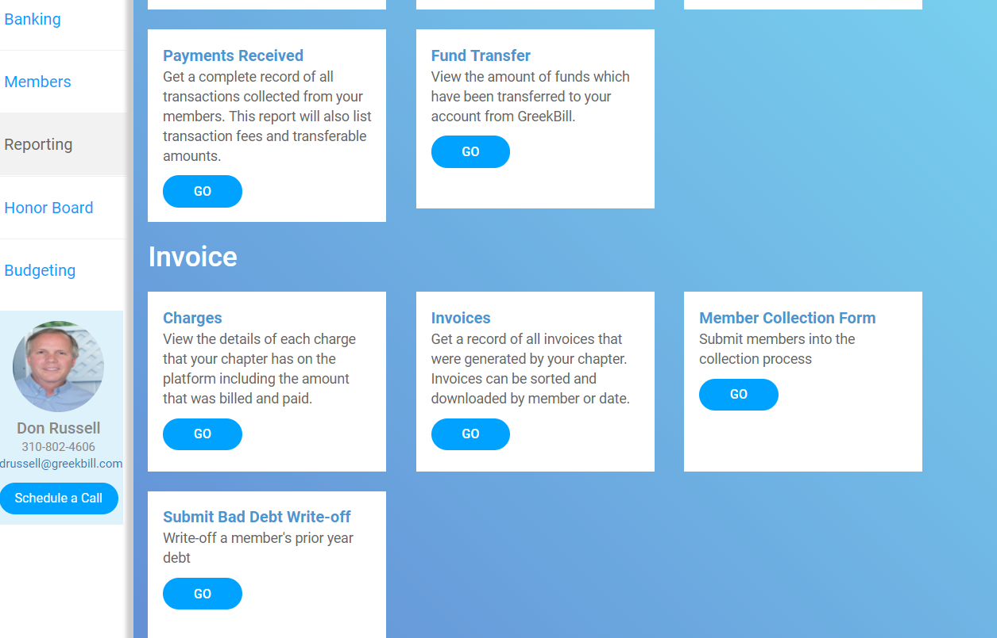
Submit Bad Debt Write Off (BDWO)
Notes:
(1 minute)
We can use Collections for past collegiate members that owe over $750.00. If they owe less than that, Bad Debt Write-Off may be a good option for the chapter.
Does anyone know what criteria must be met in order to complete the BDWO process for an individual? Feel free to type into the chat box.
Listen for the following:
Debt must be less than 750. If more than 750, complete the collection form.
Individual must be an alumna or non-member.

Slide 40
Bad Debt Write Offs (BDWO)
Best implemented on those that only owe a “small amount”, but are unresponsive/don’t feel obligated to pay
Usually owes less than $750
Can only write off debt for those that are:
An alumna
Been expelled
Have resigned
BDWO’s are submitted through GB by the chapter and are formally processed by EO
Submitted through:
Account Admin
Submit Bad Debt Write Off
Notes:
(1 minute)
Review the slide.

Slide 41
BUDGET PREPARATION – MEMBER SURVEY
Notes:
(1 minute)
The last item we will discuss today is foreshadowing to the budget work you and the chapter will do in the spring term. In the fall semester, we use our chapter budget to direct chapter spending and ensure the chapter’s fiscal well-being. New budgets will be created throughout the spring. However, an essential step to the budgeting process begins at the end of the fall term – the member survey.

Slide 42
Budget Member Survey
ALL members must complete the budget member survey – even graduating seniors!
Completed based on their plans for the next academic year
Returning to the chapter
Graduating
Studying abroad
Pursing academic professional excused status
Living in the chapter facility if applicable
Notes:
(3 Minutes)
The chapter roster and member’s plans for the following academic year directly impacts the chapter budget. How many members will be living in the chapter facility? How many members are graduating and not returning next year? Are there members who plan to study abroad or pursue academic excused status? All of these things impact the amount an income a chapter will receive.
At the end of the fall, the chapter will be asked to complete a member survey. ALL members must complete the survey.
Review slide

Slide 43
Wrap Up & Resources
Collegiate Finance Handbook
Greekbill support site tutorials
Finance team support:
RFS
Director of Finance
Director of Collegiate Budgeting
Collegiate Finance team at EO
Notes:
(5 Minutes)
We know that we covered a lot of information today, but we also know that you will likely have more questions after we conclude or time together today. In the next session of our ATA training, you will have an opportunity to network with other advisers. This may be a good time to ask questions on advising strategies or share tips on how to work with collegiate officers.
In addition, we want to ensure you are aware of these resources that are available to you as a CFA.

Slide 44
QUESTIONS?
Notes:
Allow remaining time to be used for questions and answers.
If no one has questions, you can prompt conversation and sharing with these questions to the group:
In your experience as a CFA, what is one thing you do that you feel makes the most impact to the chapter?
What is something you are most concerned about as a CFA?
What is a goal you have as a CFA this term?

